Slide 1

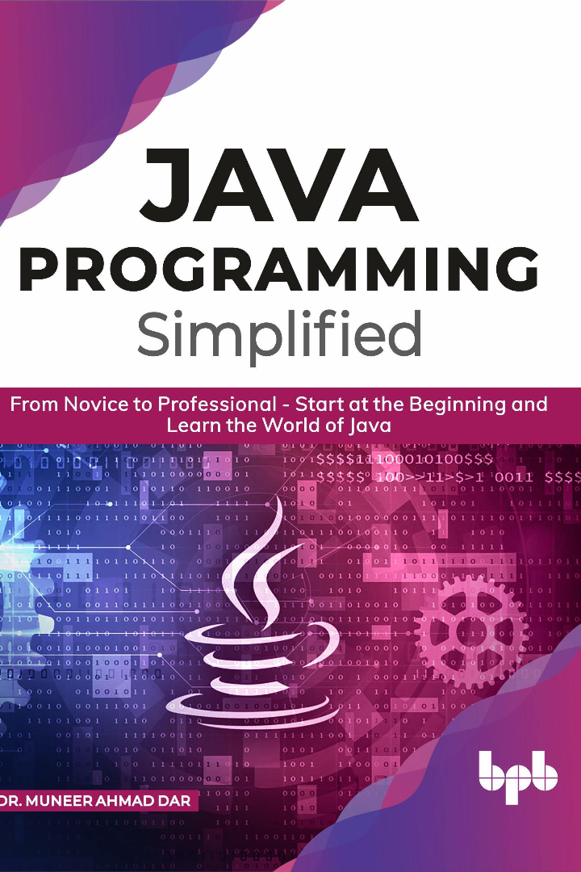

Introduction and History of Java: Exploring the Language's Basics
Java was originally developed by James Gosling at Sun Microsystems. It was released in May 1995 as a core component of Sun Microsystems' Java platform.
by AKULA KUSUMANJALI

Slide 2

Origins and Development of Java
1
Creation at Sun Microsystems
James Gosling and his team developed Java language at Sun Microsystems in the early 1990s.
2
Public Release
Java was first publicly released in 1995 and gained quick popularity due to its simplicity and versatility.
3
Acquisition by Oracle
In 2010, Oracle Corporation acquired Sun Microsystems, becoming the official steward of the Java platform.

Slide 3

Key Concepts in Java
Object-Oriented Programming
Platform Independence
Java follows the OOP paradigm, allowing developers to organize code into reusable objects with properties and methods.
Java programs can run on any platform with a Java Virtual Machine (JVM), making it highly portable.
Syntax and Structure
Java employs a syntax similar to C++, making it easy for programmers familiar with C++ or C# to learn.

Slide 4
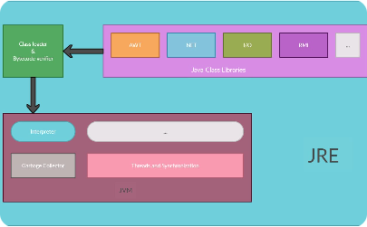
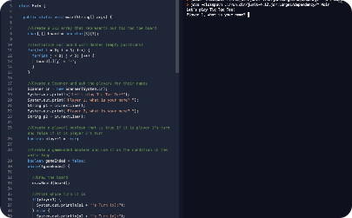
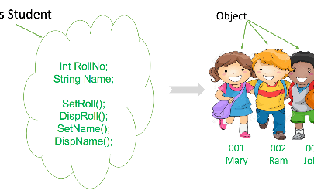
Java Basics
Setting up the Java Environment
Writing and Executing a Simple Program
Understanding Java Classes and Objects
Install a JDK (Java Development Kit) and set up the necessary environment variables to begin coding in Java.
Create a basic Java program, compile it, and run it using a Java IDE (Integrated Development Environment) or command line.
Learn how to create classes, define properties and methods, instantiate objects, and use them within your program.

Slide 5
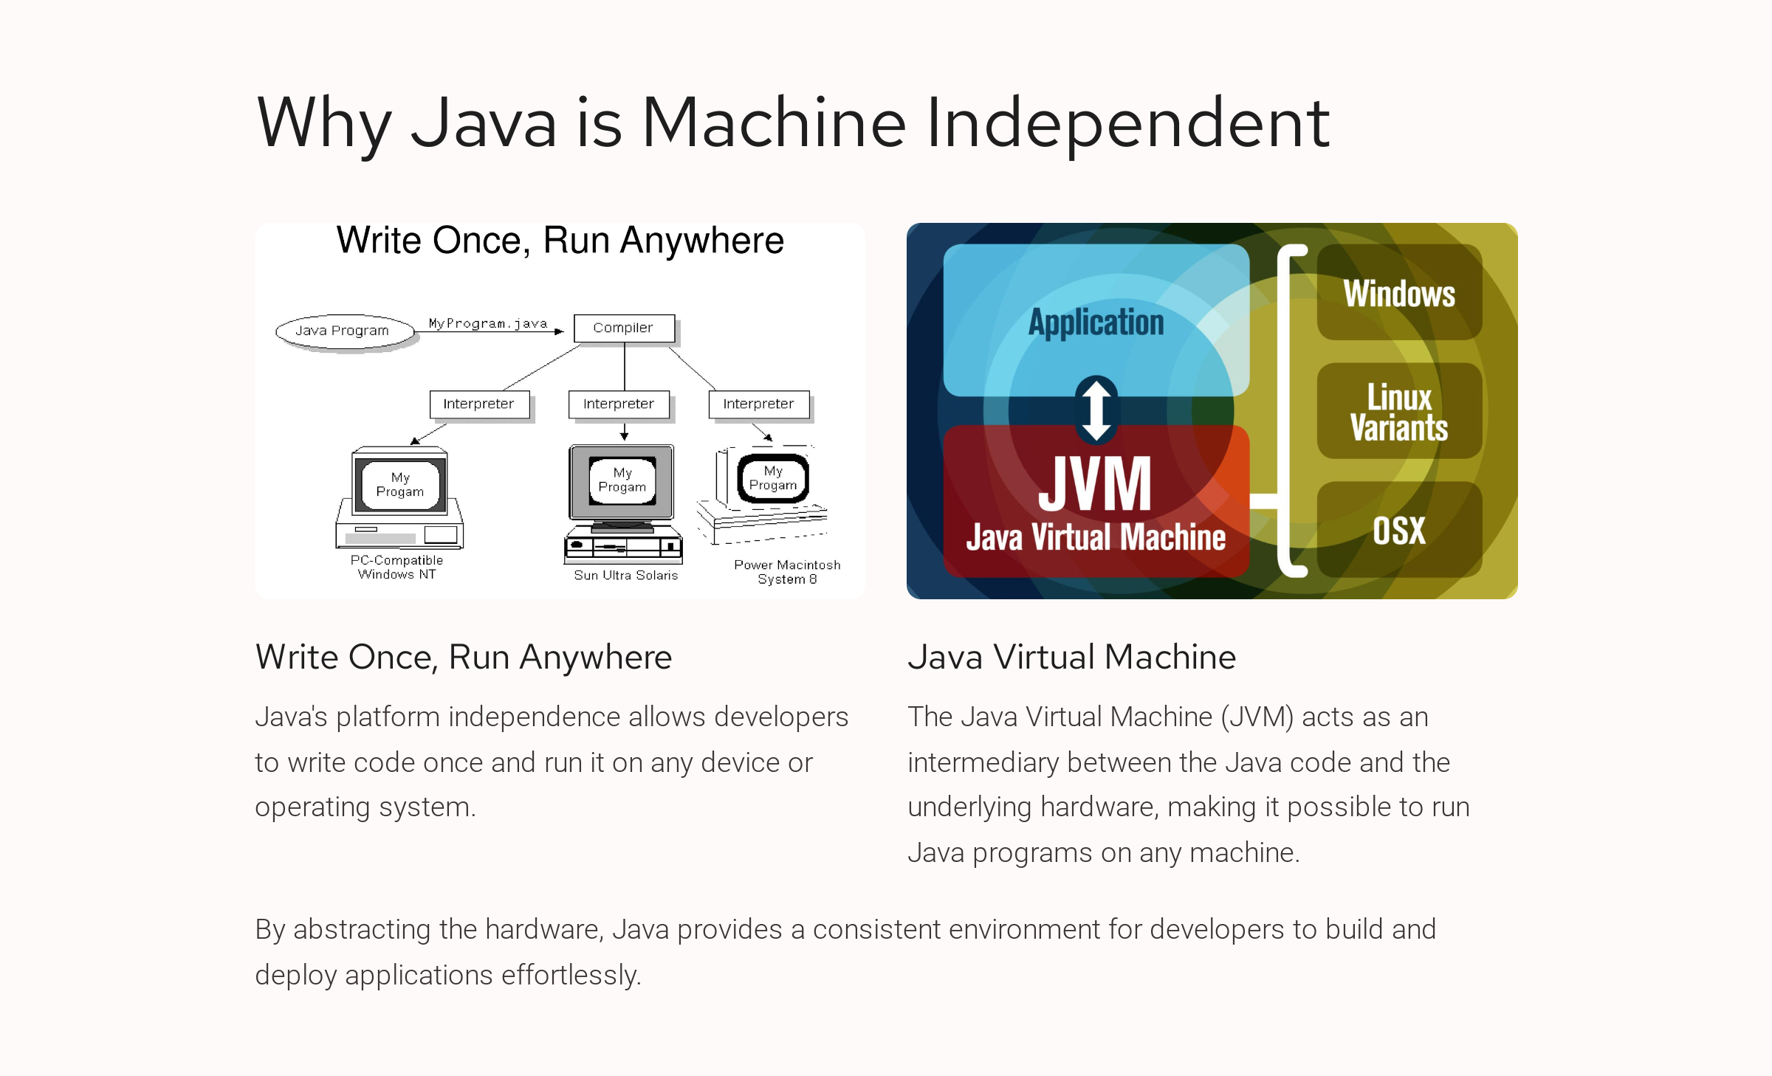

Slide 6

Using Built-in Classes and Libraries
1
Extensive Standard Library
2
Third-Party Libraries
3
Importing and Using Libraries
Java provides a wide range of built-in classes and libraries for common tasks like input/output, networking, and database connectivity.
Java has a vibrant ecosystem with numerous third-party libraries and frameworks available for various purposes and domains.
Learn how to import external libraries into your Java projects and utilize their functionality to enhance your applications.

Slide 7
Interesting Facts about Java
Guinness World Records
Influence on Programming Languages
Java Applets and Their Decline
Java holds the Guinness World Record for the largest Java project, consisting of 65 million lines of code!
Java applets, once popular for web interactivity, lost popularity with the rise of modern JavaScript frameworks.
Java heavily influenced other programming languages, including C#, Kotlin, and Scala, through its syntax and concepts.

Slide 8

Java's Role in Enterprise-Level Applications
1
Scalable and Robust
Java's strong reliability and scalability make it a go-to choice for developing enterprise-level applications.
2
Enterprise Frameworks
Frameworks like Spring and Java EE provide powerful tools and utilities to streamline enterprise application development.
3
Integration Capabilities
Java seamlessly integrates with various systems and databases, making it suitable for complex enterprise architectures.

Slide 9
Conclusion: Embracing the Power of Java
1
Recap of Main Points
2
Importance of Learning Java
Java, a versatile and powerful programming language, offers platform independence, great tooling, and extensive libraries.
Mastering Java can open doors to numerous career opportunities and enable you to develop a wide range of applications.
3
Resources for Further Learning
Explore online tutorials, documentation, and books to deepen your knowledge and expand your Java skills.

